Slide 1

Predicting Ethereum
By Giovanni Hermosillo

Slide 2
Situation
Cryptocurrency started in 2008
Increase in popularity and recognition over the years
More and more investors want to start diversifying into it

Slide 3
Problem
As more investors are wanting to diversify their assets, many are left wondering where to start

Slide 4

Approach
Create a model that will help investors decide when to buy/sell their Ethereum
Use the S&P 500 as a basis for predicting Ethereum

Slide 5

Why S&P 500?
Its an index of the 500 largest U.S. publicly traded companies
It acts as a benchmark for the overall market performance

Slide 6

Why Ethereum?
The oldest cryptocurrency after Bitcoin
It’s used to make money, create smart contracts, develop apps, etc.

Slide 7
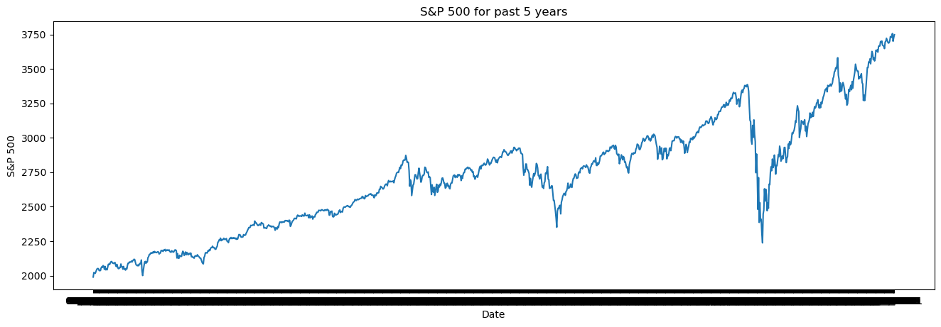
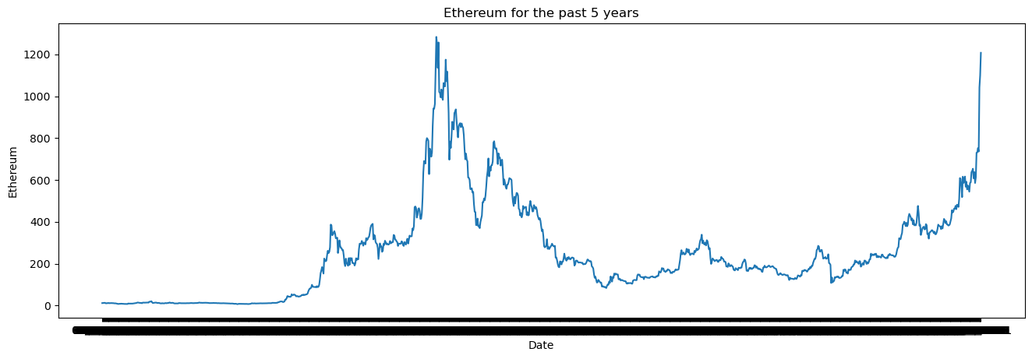
S&P 500 vs. Ethereum Performance

Slide 8
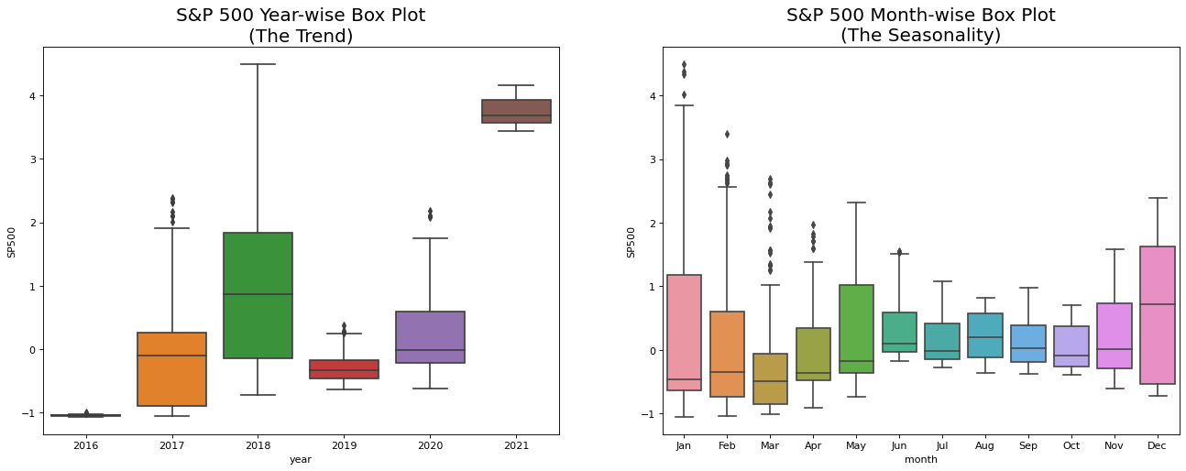
S&P 500 Trends

Slide 9
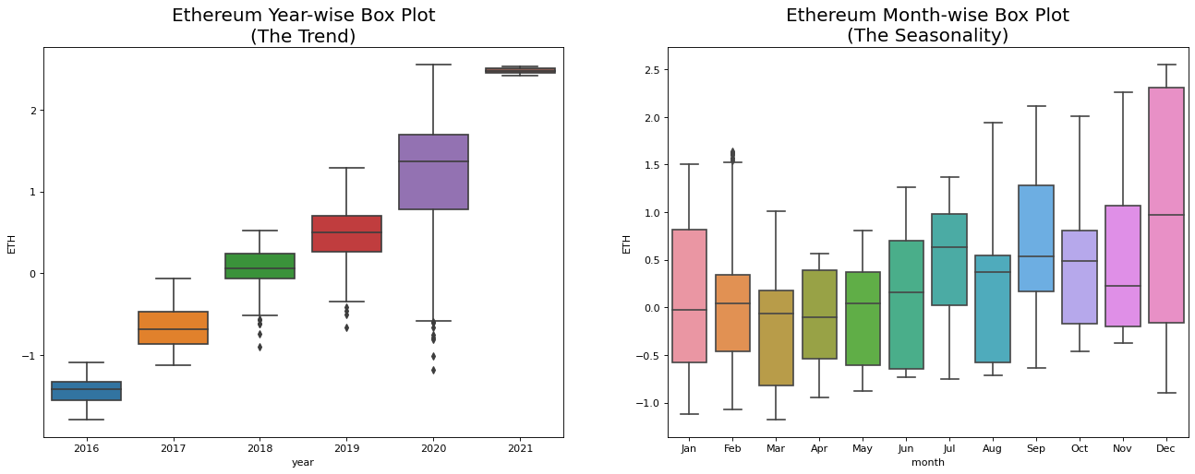
Ethereum Trends

Slide 10

Model Functions
Takes the past performance of the S&P 500 and Ethereum
Predicts if the price of Ethereum will increase/decrease

Slide 11
Recommendations
1st recommendation: Use model as an investment trading assistance tool
2nd recommendation: Use trending plots for yearly decisions
3rd recommendation: Research other cryptocurrencies

